Slide 1

Heart Disease Prediction
machine learning classification projects Team members: Abdelrahman alaa, Tawfik Melad

Slide 2
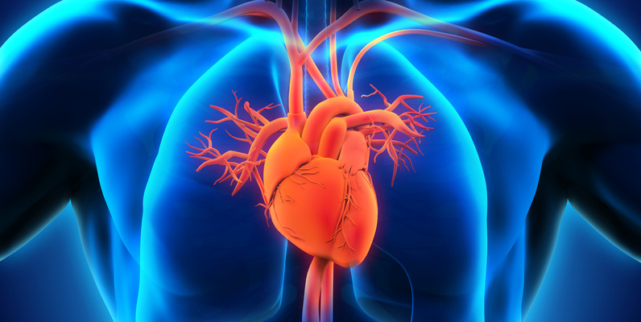
Problem Definition
Heart disease is a major health concern worldwide and can lead to serious health complications and even death.
There are several factors associated with heart disease as high blood pressure, cholesterol, smoking, and family history of heart disease.
Machine learning can be used to predict the likelihood of heart disease based on various risk factors.

Slide 3

Used Dataset
Features (13 columns) age, sex, chest pain type, resting blood pressure, cholesterol, fasting blood sugar, resting electrocardiogram (ECG), ….etc.
Labels: 0 = normal, 1 = fixed defect
The dataset contains 1025 rows.
508 cases of coronary heart disease (CHD) which is 62%
410 cases without CHD which is 38%

Slide 4

Preprocessing
Removing duplicated data.
Removing null values.
Separating data into categorical and numerical.
Encoding the categorical values.
Applied feature scaling to numerical values to make them all in same range.

Slide 5
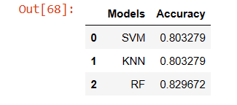
Algorithm Used
SVM Accuracy: 80.33%
KNN Accuracy: 80.33%
Random Forest: 82.96%
Highest Accuracy is Random Forest!!

Slide 6
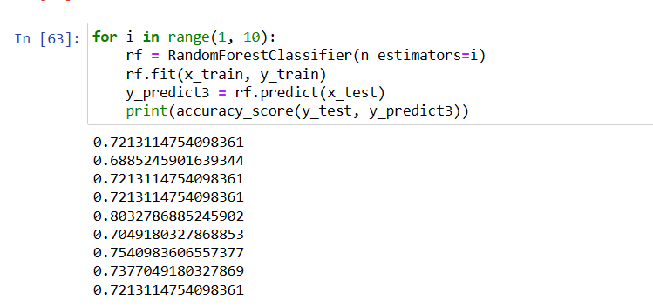
RF Analysis
Random Forest Problems
The accuracy varies every time we train the model.
RF uses random sampling to create different decision trees every time it's trained.
These variations cause differences in the model accuracy varies from 68% to 80%
Min accuracy 68%
Max accuracy 80%

Slide 7
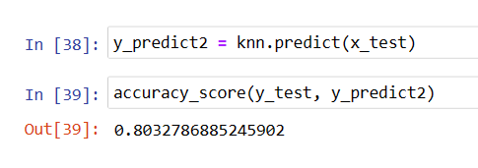
Algorithm Used
Move forward with KNN algorithm

Slide 8
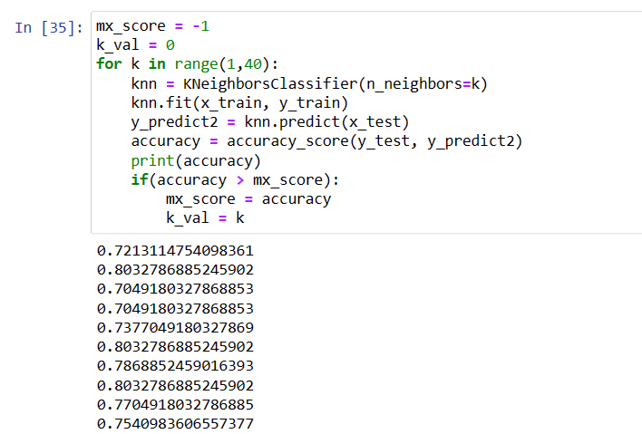
KNN Algorithm
Hyper parameter tuning
The default K neighbor value is not the best value.
Tried different values of K to get the best accuracy.
The most suitable K value = 2

Slide 9
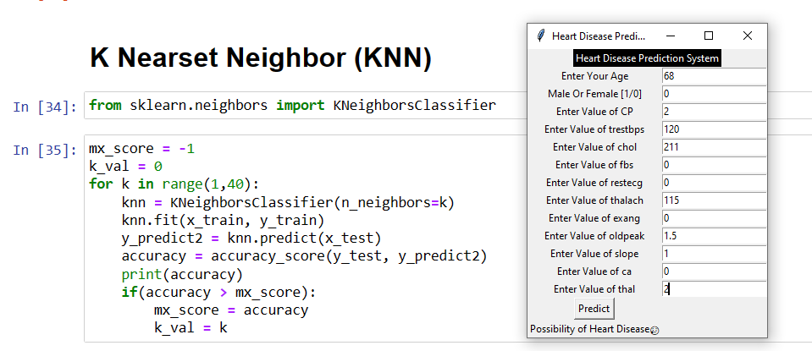
Result
Possibility of Heart Disease 😥

Slide 10
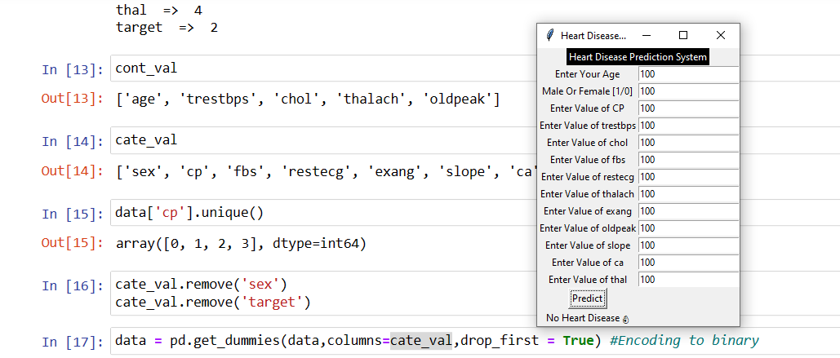
Result
No Heart Disease 👌

Slide 11
Conclusion
The project aims to predict heart disease in patients using ML.
After obtaining and cleaning the dataset by removing null and duplicate values, categorical and numerical columns were separated.
The K-Nearest Neighbors (KNN) algorithm was chosen to train the model and achieved good performance with an accuracy of 80%
Finally, the model was saved using the joblib library, which allows it to be loaded and used in other applications and tested using GUI.
The project demonstrates how ML algorithms can be used to predict heart disease in patients with good accuracy, which can aid in early detection and treatment of the disease.

Slide 12

THANKS Any Questions?

